Slide 1
I210 – Introduction to Programming with Python
Lecture 11

Slide 2

Today
Formatting Output
Nested Sequences
Table Print

Slide 3
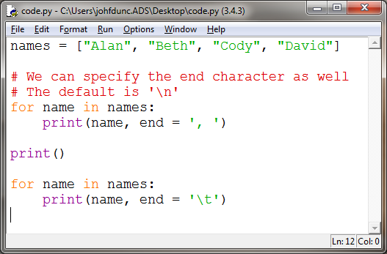
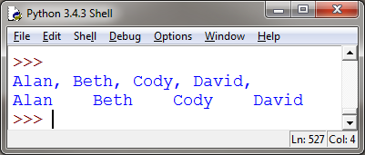
Formatting Output
We’ve seen that we can control the end character to suppress the automatic newline:

Slide 4
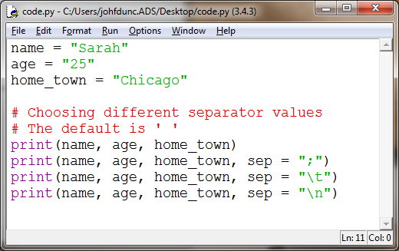
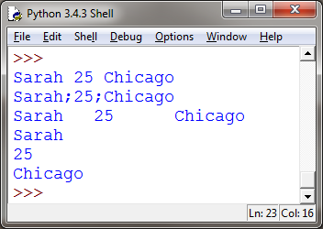
Formatting Output
We can also automatically insert a separator when we print:

Slide 5
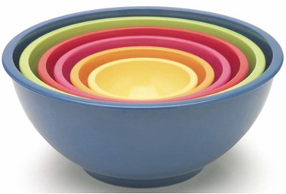
Nested Sequences
Lists and Tuples can have other Lists and Tuples as items (nesting)!!
nested_list = [("Python","PHP"), "Hello", [23, 4]]
nested_tuple = (("Python","PHP"), "Hello", [23, 4])

Slide 6
Nested Sequences
scores = [("Abe", 200), ("Bill", 180), ("Mary", 215)]
We can think of this list as a table:
 | Name (col 0) | Score (col 1)
Row 0 | “Abe” | 200
Row 1 | “Bill” | 180
Row 2 | “Mary” | 215

Slide 7
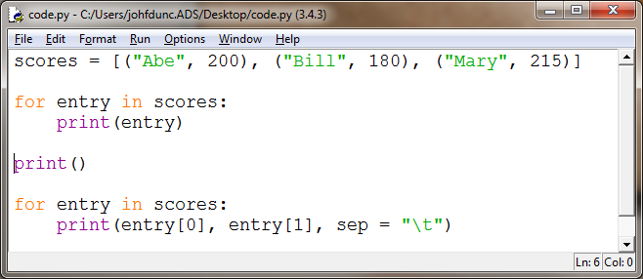
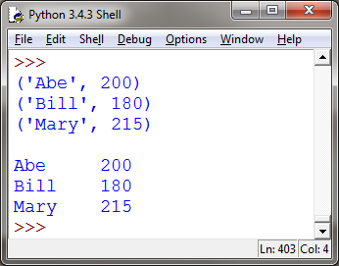
Nested Sequences
Compare the output for these methods of printing the contents of a nested sequence:
Which one looks more like a table?

Slide 8
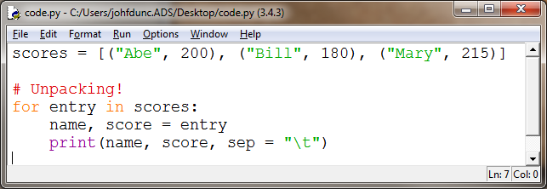
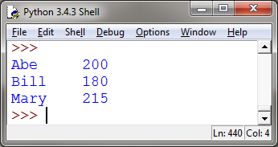
Nested Sequences
If we know exactly how many pieces are in the inner sequence, we can do what’s called unpacking.
Unpacking assigns the pieces of the inner sequence to multiple variables at once!
This can be better when using entry[0] or entry[1] is confusing.

Slide 9
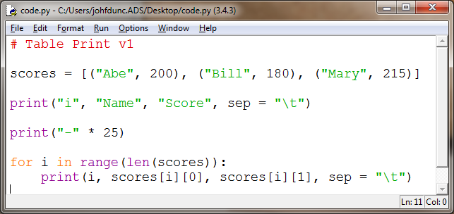
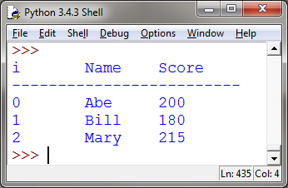
Nested Sequences (Table Print 1)
If we need index numbers, we can double index:
The value of i is the row – it determines which tuple we have.
The [0] or [1] after it gets us the name or score from that tuple.
i | Name (col 0) | Score (col 1)
Row 0 | “Abe” | 200
Row 1 | “Bill” | 180
Row 2 | “Mary” | 215

Slide 10
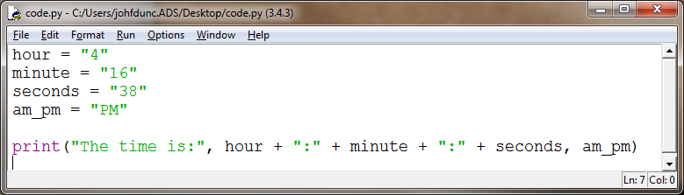
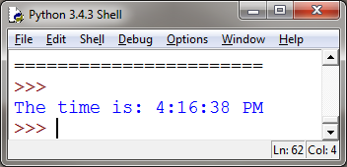
Formatting Output
We run into this situation a lot, where we need to output a lot of variables in a very specific way:
I ran this program 3 times before I got everything to line up the way I wanted!

Slide 11
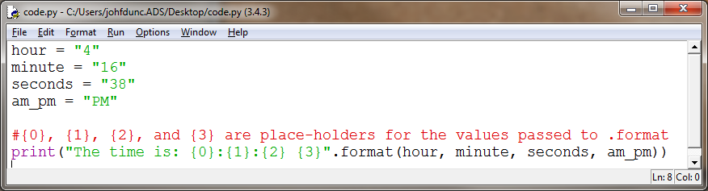
Formatting Output
Python provides the .format() method for strings, which can make this process less error-prone:
We can immediately see what the final output will look like by how we space the { }

Slide 12
Formatting Output
Let’s say we want to print out a date as Month Day, Year:
month = "May"
day = 23
year = 2016
output = "{0} {1}, {2}"
print(output.format(month, day, year))
>> May 23, 2016
Notice that .format also converts the ints to strings.

Slide 13
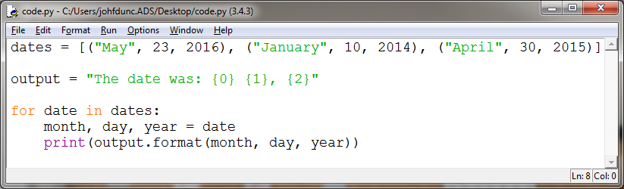
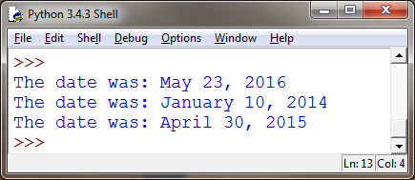
Formatting Output
If we need to print out several dates, it's now very easy to do so by changing the variables we pass to .format

Slide 14
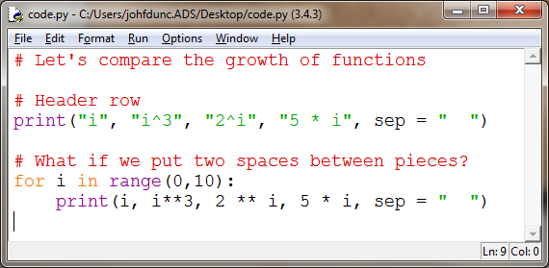
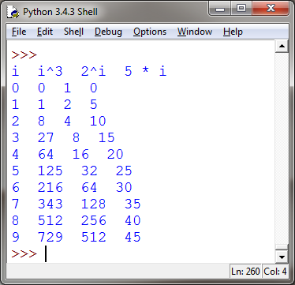
Formatting Output
Let’s say we want to compare the growth of 3 functions: n³ 2^{n} 5n

Slide 15
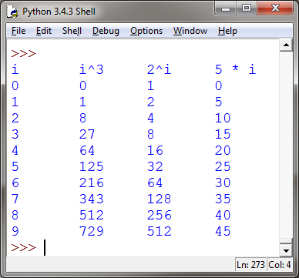
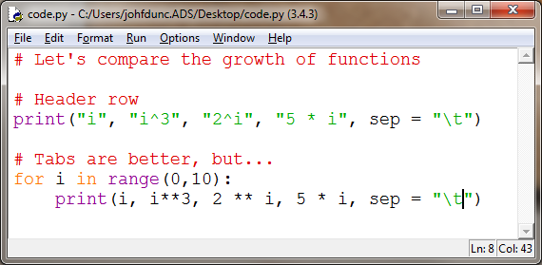
Formatting Output
Let’s say we want to compare the growth of 3 functions: n³ 2^{n} 5n

Slide 16
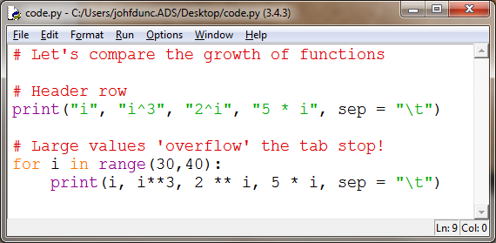
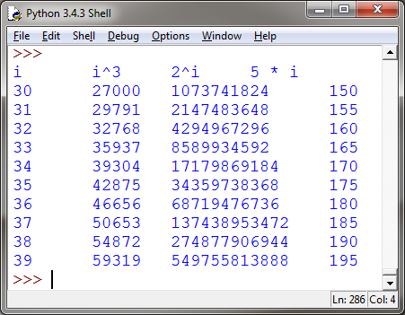
Formatting Output
Let’s say we want to compare the growth of 3 functions: n³ 2^{n} 5n

Slide 17
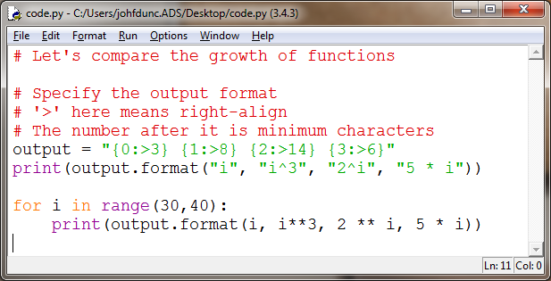
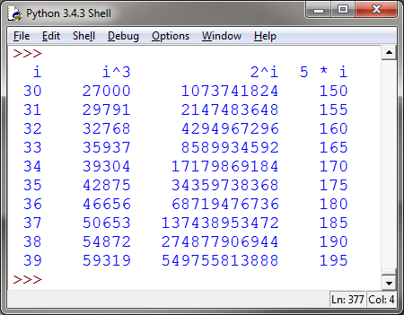
Formatting Output
.format() also allows us to specify a minimum number of characters AND whether we want to left-align or right-align the data:

Slide 18
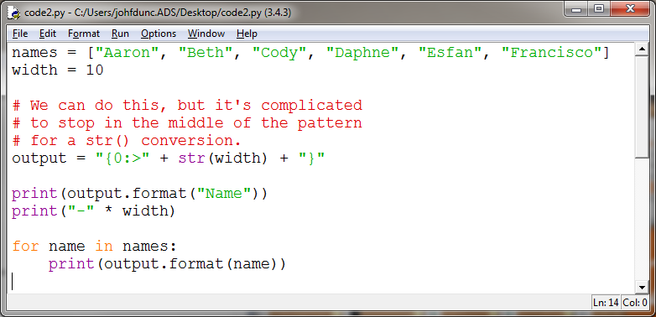
Formatting Output
If we want to control the width, we have options.

Slide 19
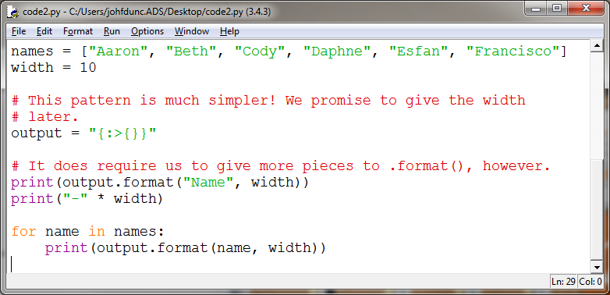
Formatting Output
If we want to control the width, we have options.

Slide 20
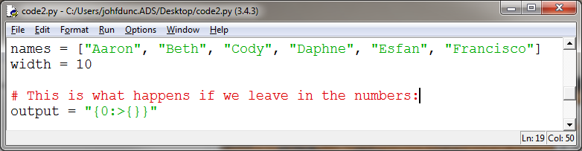
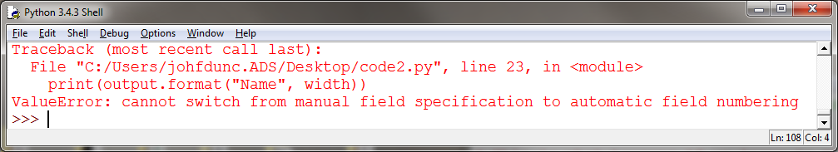
Formatting Output
We have to be careful to remove the numbers in our placeholders! Otherwise…

Slide 21
Questions?

